Slide 1
Focus on Pharmacology:
Essentials for Health Professionals
Third Edition
Chapter 28
Drugs Used to Treat Vascular Conditions

Slide 2
Introduction
Hypertension
  Most common cardiovascular disorder
  Affects black males most of all
  If uncontrolled, may lead to:
    Kidney failure
    Stroke
    Cardiac arrest
    Congestive heart failure
continued on next slide

Slide 3
Introduction
Hypertension
  Systolic blood pressure of 140 mm Hg or higher
  Diastolic blood pressure of 90 mm Hg or higher
Prehypertension
  Systolic blood pressure of 120–139 mm Hg
  Diastolic blood pressure of 80–89mm Hg
Normal
  Systolic blood pressure of 119 mm Hg or less
  Diastolic blood pressure of 79 mm Hg or less

Slide 4
The Vascular System
Three components
  Arterial pressure
  Capillary pressure
  Venous pressure
Blood pressure (BP)
  Created by pumping action of heart
  In arteries, BP
    Rises during ventricular systole
    Falls during ventricular diastole
continued on next slide

Slide 5
The Vascular System
Factors Affecting Blood Pressure
  Cardiac output
    Volume of blood pumped per minute, determined by
      Heart rate
      Stroke volume
        Amount of blood pumped by ventricle in one contraction
  Peripheral resistance
    Friction in arteries as blood flows through
  Blood volume
    Amount of blood in vascular system
continued on next slide

Slide 6
The Vascular System
Vasomotor center
  Neuron cluster in medulla oblongata
    Signals smooth muscle of arteries to constrict or relax
  Baroreceptors sense pressure in large vessels.
  Chemoreceptors monitor:
    Oxygen levels
    Carbon dioxide levels
    Blood acidity (pH)
continued on next slide

Slide 7
Regulation of BP
Walls of Arteries and Veins
  Three distinct layers
    Tunica interna (innermost)
      Endothelial lining, underlying connective tissue
    Tunica media (middle)
      Smooth muscle tissue in collagen and elastic fiber framework
    Tunica externa (outer)
      Sheath of connective tissue around the vessel

Slide 8
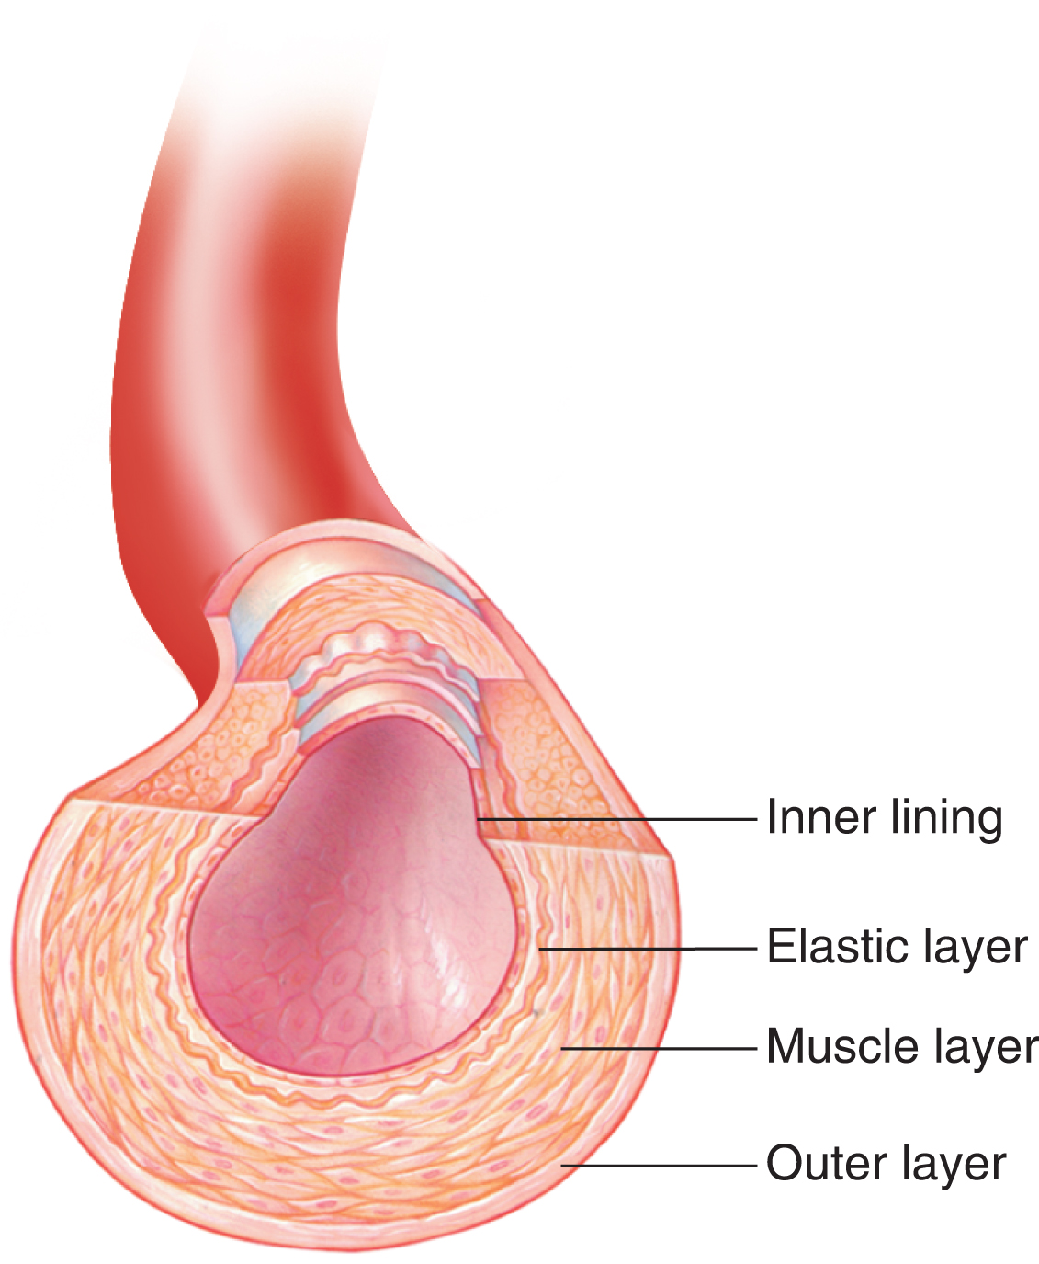
Figure 28-1 The structure of an artery, showing the outer protective layer, muscle layer, elastic layer, and inner lining.
© Dorling Kindersley.

Slide 9
Hypertension
Primary hypertension
  90% of cases
  Unknown cause
Secondary hypertension linked to:
  Glomerulonephritis
  Pyelonephritis
  Polycystic renal disease
  Endocrine disorders
continued on next slide

Slide 10
Hypertension
Major cause of:
  CVA
  Cardiac disease
  Renal failure
Hypertensive crisis
  Severe elevation of BP

Slide 11
Table 28-1 Classification of Blood Pressure in Adults
CLASSIFICATION | SYSTOLIC (mm Hg) | DIASTOLIC (mm Hg)
Normal | < 120 and | < 80
Prehypertension | 120–139 or | 80–89
Stage I hypertension | 140–159 or | 90–99
Stage II hypertension | ≥ 160 or | ≥ 100

Slide 12
Hypertension
Antihypertensive Agents
  Diuretics
    Reduce blood volume
  Beta-blockers
    Slow heart rate
    Dilate vessels
  Vasodilators
    Dilate vessels
continued on next slide

Slide 13
Hypertension
Antihypertensive Agents
  Calcium channel blockers
    Slow heart rate
    Reduce conduction irritability
    Dilate vessels
  ACE inhibitors
    Vasodilate
    Increase renal blood flow
  Angiotensin-receptor blockers (ARBs)
    Block vasoconstriction

Slide 14
Table 28-2 Most Commonly Prescribed Antihypertensive Agents
GENERIC NAME | TRADE NAME | AVERAGE ADULT DOSAGE | ROUTE OF ADMINISTRATION
Diuretics
Beta-Adrenergic Blockers (Beta-Blockers)
acebutolol | Sectral | 200–800 mg bid | PO
atenolol | Tenormin | 25–100 mg/d | PO
betaxolol | Kerlone | 10–20 mg/d | PO
bisoprolol | Zebeta | 2.5–20 mg/d | PO
metoprolol | Lopressor | 50–450 mg/d | PO
nadolol | Corgard | 40–320 mg/d | PO
penbutolol | Levatol | 20–80 mg/d | PO
bid, twice a day; PO, oral; IV, intravenous; tid, three times a day; qid, four times a day; IM, intramuscular.
continued on next slide

Slide 15
Table 28-2 Most Commonly Prescribed Antihypertensive Agents
GENERIC NAME | TRADE NAME | AVERAGE ADULT DOSAGE | ROUTE OF ADMINISTRATION
Diuretics
Beta-Adrenergic Blockers (Beta-Blockers)
pindolol | Visken | up to 60 mg/d | PO
propranolol | Inderal | 10–240 mg/d | PO
timolol | Blocadren | 20–60 mg/d | PO
bid, twice a day; PO, oral; IV, intravenous; tid, three times a day; qid, four times a day; IM, intramuscular.
continued on next slide

Slide 16
Table 28-2 Most Commonly Prescribed Antihypertensive Agents
GENERIC NAME | TRADE NAME | AVERAGE ADULT DOSAGE | ROUTE OF ADMINISTRATION
Diuretics
Alpha-Adrenergic and Beta-Adrenergic Blockers
labetalol | Trandate (Generic only) | 100–400 mg PO bid (maximum: 1,200–2,400 mg/d) 20 mg slowly over 2 min, with 40–80 mg q10min if needed (maximum: 300 g total dose) | PO IV
bid, twice a day; PO, oral; IV, intravenous; tid, three times a day; qid, four times a day; IM, intramuscular.
continued on next slide

Slide 17
Table 28-2 Most Commonly Prescribed Antihypertensive Agents
GENERIC NAME | TRADE NAME | AVERAGE ADULT DOSAGE | ROUTE OF ADMINISTRATION
Diuretics
Centrally Acting Blockers
clonidine | Catapres Catapres-TTS | 0.1–0.8 mg bid Apply patch q7d | PO Transdermal
guanabenz | (Generic only) | 4–32 mg bid | PO
guanfacine | Tenex | 1–3 mg bid | PO
methyldopa | (Generic only) Methyldopate Hcl | 250 mg bid–tid (maximum: 3 g/d in divided doses) 250–500 mg q6h, increased up to 1 g q6h | PO IV
bid, twice a day; PO, oral; IV, intravenous; tid, three times a day; qid, four times a day; IM, intramuscular.
continued on next slide

Slide 18
Table 28-2 Most Commonly Prescribed Antihypertensive Agents
GENERIC NAME | TRADE NAME | AVERAGE ADULT DOSAGE | ROUTE OF ADMINISTRATION
Diuretics
Peripherally Acting Blockers
doxazosin | Cardura | 1–16 mg/d | PO
guanethidine | (Generic only) | 10–50 mg/d | PO
prazosin | Minipress | 1–20 mg/d | PO
terazosin | Hytrin | 1–20 mg/d | PO
bid, twice a day; PO, oral; IV, intravenous; tid, three times a day; qid, four times a day; IM, intramuscular.
continued on next slide

Slide 19
Table 28-2 Most Commonly Prescribed Antihypertensive Agents
GENERIC NAME | TRADE NAME | AVERAGE ADULT DOSAGE | ROUTE OF ADMINISTRATION
Diuretics
Calcium Channel Blockers
amlodipine with benazepril | Lotrel | 2.5 mg amlodipine/10 mg benazepril per day | PO
diltiazem | Cardizem | 80–120 mg tid | PO
felodipine | Plendil | 5–10 mg/d | PO
isradipine | DynaCirc | 1.25–10 mg bid | PO
bid, twice a day; PO, oral; IV, intravenous; tid, three times a day; qid, four times a day; IM, intramuscular.
continued on next slide

Slide 20
Table 28-2 Most Commonly Prescribed Antihypertensive Agents
GENERIC NAME | TRADE NAME | AVERAGE ADULT DOSAGE | ROUTE OF ADMINISTRATION
Diuretics
Calcium Channel Blockers
nicardipine | Cardene SR | 20–40 mg tid | PO
nifedipine | Procardia, Adalat CC | 10–20 mg tid | PO
nisoldipine | Sular | 10–20 mg tid | PO
verapamil | Calan, Verelan | 40–80 mg tid | PO
bid, twice a day; PO, oral; IV, intravenous; tid, three times a day; qid, four times a day; IM, intramuscular.
continued on next slide

Slide 21
Table 28-2 Most Commonly Prescribed Antihypertensive Agents
GENERIC NAME | TRADE NAME | AVERAGE ADULT DOSAGE | ROUTE OF ADMINISTRATION
Diuretics
Angiotensin II Receptor Blockers
bisoprolol | Zebeta | 2.5–5 mg/d (maximum: 20 mg/d) | PO
candesartan | Atacand | 8–32 mg/d | PO
eprosartan | Teveten | 400–800 mg/d | PO
irbesartan | Avapro | 150–300 mg/d | PO
bid, twice a day; PO, oral; IV, intravenous; tid, three times a day; qid, four times a day; IM, intramuscular.
continued on next slide

Slide 22
Table 28-2 Most Commonly Prescribed Antihypertensive Agents
GENERIC NAME | TRADE NAME | AVERAGE ADULT DOSAGE | ROUTE OF ADMINISTRATION
Diuretics
Angiotensin II Receptor Blockers
losartan | Cozaar | 25–50 mg 1–2 times/d | PO
olmesartan | Benicar | 20–40 mg/d | PO
valsartan | Diovan | 80–160 mg/d | PO
telmisartan | Micardis | 40–80 mg/d | PO
bid, twice a day; PO, oral; IV, intravenous; tid, three times a day; qid, four times a day; IM, intramuscular.
continued on next slide

Slide 23
Table 28-2 Most Commonly Prescribed Antihypertensive Agents
GENERIC NAME | TRADE NAME | AVERAGE ADULT DOSAGE | ROUTE OF ADMINISTRATION
Diuretics
Angiotensin-Converting Enzyme Inhibitors
benazepril | Lotensin | 4–50 mg/d | PO
captopril | Capoten | 25/100 mg/d | PO
enalapril | Vasotec | 5–40 mg/d | PO
fosinopril | Monopril | 10–40 mg/d | PO
lisinopril | Prinivil, Zestril | 10–40 mg/d | PO
bid, twice a day; PO, oral; IV, intravenous; tid, three times a day; qid, four times a day; IM, intramuscular.
continued on next slide

Slide 24
Table 28-2 Most Commonly Prescribed Antihypertensive Agents
GENERIC NAME | TRADE NAME | AVERAGE ADULT DOSAGE | ROUTE OF ADMINISTRATION
Diuretics
Angiotensin-Converting Enzyme Inhibitors
moexipril | Univasc | 7.5–30 mg/d | PO
perindopril | Aceon | 2.5–20 mg/d | PO
quinapril | Accupril | 2–8 mg/d | PO
ramipril | Altace | 2.5–5 mg/d | PO
trandolapril | Mavik | 1–4 mg/d | PO
bid, twice a day; PO, oral; IV, intravenous; tid, three times a day; qid, four times a day; IM, intramuscular.
continued on next slide

Slide 25
Table 28-2 Most Commonly Prescribed Antihypertensive Agents
GENERIC NAME | TRADE NAME | AVERAGE ADULT DOSAGE | ROUTE OF ADMINISTRATION
Vasodilators
fenoldopam | Corlopam | 0.025–0.3 mcg/kg/min by continuous infusion for up to 48 h | IV
hydralazine | (Generic only) (Generic only) (Generic only) | 10–50 mg qid 10–40 mg q4–6h 10–40 mg q4–6h | PO IM IV
bid, twice a day; PO, oral; IV, intravenous; tid, three times a day; qid, four times a day; IM, intramuscular.
continued on next slide

Slide 26
Table 28-2 Most Commonly Prescribed Antihypertensive Agents
GENERIC NAME | TRADE NAME | AVERAGE ADULT DOSAGE | ROUTE OF ADMINISTRATION
Vasodilators
minoxidil | Loniten Rogaine | 5 mg/d, increased q3–5d up to 40 mg/d in single or divided doses as needed (maximum: 100 mg/d) 1 mL/d onto scalp | PO Topical solution
bid, twice a day; PO, oral; IV, intravenous; tid, three times a day; qid, four times a day; IM, intramuscular.

Slide 27
Hypertension
Antihypertensive Agents
  Beta-Adrenergic Blockers
    Very popular antihypertensive drugs
    Competitively antagonize
      Responses to catecholamines
      Mediated by beta receptors
continued on next slide

Slide 28
Hypertension
Antihypertensive Agents
  Alpha-Adrenergic and Beta-Adrenergic Blockers
    Also called alpha-blockers and beta-blockers
    Administered for mild, moderate, and severe hypertension
      Alone or in combination with other antihypertensives (especially, thiazide diuretics)
continued on next slide

Slide 29
Hypertension
Antihypertensive Agents
  Alpha-Adrenergic and Beta-Adrenergic Blockers
    Adverse effects
      Postural hypotension
      Dizziness
      Vertigo
      Headache
      Bronchospasm
      Dyspnea
continued on next slide

Slide 30
Hypertension
Antihypertensive Agents
  Alpha-Adrenergic and Beta-Adrenergic Blockers
    Contraindications
      Bronchial asthma
      Uncontrolled cardiac failure
      Cardiogenic shock
      Severe bradycardia
    Interactions
      Cimetidine
      Glutethimide
continued on next slide

Slide 31
Hypertension
Antihypertensive Agents
  Alpha-Adrenergic and Beta-Adrenergic Blockers
    Be aware of potential hypotension.
      Make position changes slowly, in stages.
    Avoid driving and other hazardous activities until drug response is known.
continued on next slide

Slide 32
Hypertension
Antihypertensive Agents
  Centrally-Acting Adrenergic Blockers
    Used when other therapies are insufficient
    Decrease systemic vascular resistance or cardiac output
    Administered for management of hypertension
      Especially combined with a diuretic
continued on next slide

Slide 33
Hypertension
Antihypertensive Agents
  Centrally-Acting Adrenergic Blockers
    Adverse effects
      Drowsiness
      Sedation
      Headache
      Nightmares
      Anxiety
      Orthostatic hypotension
continued on next slide

Slide 34
Hypertension
Antihypertensive Agents
  Centrally-Acting Adrenergic Blockers
    Adverse effects
      CHF
      Peripheral edema
      Tachycardia
      Bradycardia
      Cutaneous flush
      Hepatitis
continued on next slide

Slide 35
Hypertension
Antihypertensive Agents
  Centrally-Acting Adrenergic Blockers
    Contraindications
      Pregnancy
      Lactation
      Hepatitis
      Cirrhosis
      Blood dyscrasias
continued on next slide

Slide 36
Hypertension
Antihypertensive Agents
  Centrally-Acting Adrenergic Blockers
    Interactions
      None listed
    Avoid driving and other hazardous tasks until drug response is known.
    No OTC medications or breastfeeding until physician approves.
continued on next slide

Slide 37
Hypertension
Antihypertensive Agents
  Peripherally-Acting Adrenergic Blockers
    Lower BP, mostly affecting diastolic
    Reduce vascular tone
    Administered for:
      Severe hypertension
      Or as adjunctive therapy with other agents
continued on next slide

Slide 38
Hypertension
Antihypertensive Agents
  Peripherally-Acting Adrenergic Blockers
    Adverse effects
      Drowsiness
      Fatigue
      Headache
      Confusion
      Palpitation
      Dry mouth
      Dyspnea
      Nausea, vomiting
continued on next slide

Slide 39
Hypertension
Antihypertensive Agents
  Peripherally-Acting Adrenergic Blockers
    Contraindications
      History of depression
      Peptic ulcer
      Ulcerative colitis
    Interaction
      Alcohol
continued on next slide

Slide 40
Hypertension
Antihypertensive Agents
  Peripherally-Acting Adrenergic Blockers
    Be aware of orthostatic hypotension.
      Ask for help when getting out of bed during early use of agents.
    Take same time each day.
    No OTC drugs till physician approves for:
      Colds
      Allergies
      Asthma
      Appetite suppression
continued on next slide

Slide 41
Hypertension
Antihypertensive Agents
  Calcium Channel Blockers
    Reduce electrical conduction
    Decrease contraction force
    Dilate arteries
continued on next slide

Slide 42
Hypertension
Antihypertensive Agents
  Calcium Channel Blockers
    Administered for:
      Hypertension
      Raynaud’s phenomenon
      Angina
      Cardiomyopathy
      Atrial fibrillation
      Migraine headaches
      Subarachnoid hemorrhage
      Pulmonary hypertension
      Paroxysmal supraventricular tachycardia
continued on next slide

Slide 43
Hypertension
Antihypertensive Agents
  Calcium Channel Blockers
    Adverse effects
      Headache
      Constipation
      Rash
      Nausea
      Flushing
      Edema
      Drowsiness
      Dizziness
      Hypotension
continued on next slide

Slide 44
Hypertension
Antihypertensive Agents
  Calcium Channel Blockers
    Contraindications
      Advanced aortic stenosis
      Severe bradyarrhythmia
      Sick sinus syndrome
      Heart block
      Hypotension
      Cardiogenic shock
      Ventricular tachycardia
continued on next slide

Slide 45
Hypertension
Antihypertensive Agents
  Calcium Channel Blockers
    Interactions
      Carbamazepine
      Simvastatin
      Atorvastatin
      Lovastatin
      Cyclosporine
      Grapefruit juice
continued on next slide

Slide 46
Hypertension
Antihypertensive Agents
  Calcium Channel Blockers
    Discuss all medical conditions with physician prior to beginning these agents.
    All current medications must be discussed.
    Avoid:
      Grapefruit
      Grapefruit juice
      Alcohol
      Other BP medications
continued on next slide

Slide 47
Hypertension
Antihypertensive Agents
  Angiotensin II Receptor Blockers
    Prevent raised BP
      Block vasoconstriction and aldosterone secretion
    Administered for:
      CHF
      Hypertension
    Adverse effects
      Similar to ACE inhibitors
      Except, they do not cause persistent cough
continued on next slide

Slide 48
Hypertension
Antihypertensive Agents
  Angiotensin II Receptor Blockers
    Contraindications
      Hypersensitivity
      Bilateral artery stenosis
      Cardiac failure
      Cardiogenic shock
      Pregnancy
      Lactation
continued on next slide

Slide 49
Hypertension
Antihypertensive Agents
  Angiotensin II Receptor Blockers
    Interactions
      Amiodarone
      Beta-blockers
    Report dizziness.
      Especially when making position changes
    Immediately report pregnancy to physician.
    Avoid breastfeeding.
continued on next slide

Slide 50
Hypertension
Antihypertensive Agents
  Angiotensin-Converting Enzyme Inhibitors
    Lower blood volume and BP
      By affecting the renin-angiotensin system
    Very popular for severe hypertension
    Becoming drugs of choice for primary hypertension
    Also used for CHF
continued on next slide

Slide 51
Hypertension
Antihypertensive Agents
  Angiotensin-Converting Enzyme Inhibitors
    Adverse effects (rare, but can be life threatening)
      Loss of taste
      Photosensitivity
      Severe hypotension
      Hyperkalemia
      Renal impairment
      Blood dyscrasias
      Dizziness
      Angioedema
continued on next slide

Slide 52
Hypertension
Antihypertensive Agents
  Angiotensin-Converting Enzyme Inhibitors
    Contraindications
      Angioedema
      Pregnancy
      Renal impairment
      Scleroderma
      Lupus
      Hypersensitivity
continued on next slide

Slide 53
Hypertension
Antihypertensive Agents
  Angiotensin-Converting Enzyme Inhibitors
    Interactions
      Potassium-sparing diuretics
      Aspirin
      Other NSAIDs
      Lithium
continued on next slide

Slide 54
Hypertension
Antihypertensive Agents
  Angiotensin-Converting Enzyme Inhibitors
    Patients must consult physician if vomiting or diarrhea occurs.
    Use OTC drugs only with physician approval.
    Inform surgeons or dentists when taking these.

Slide 55
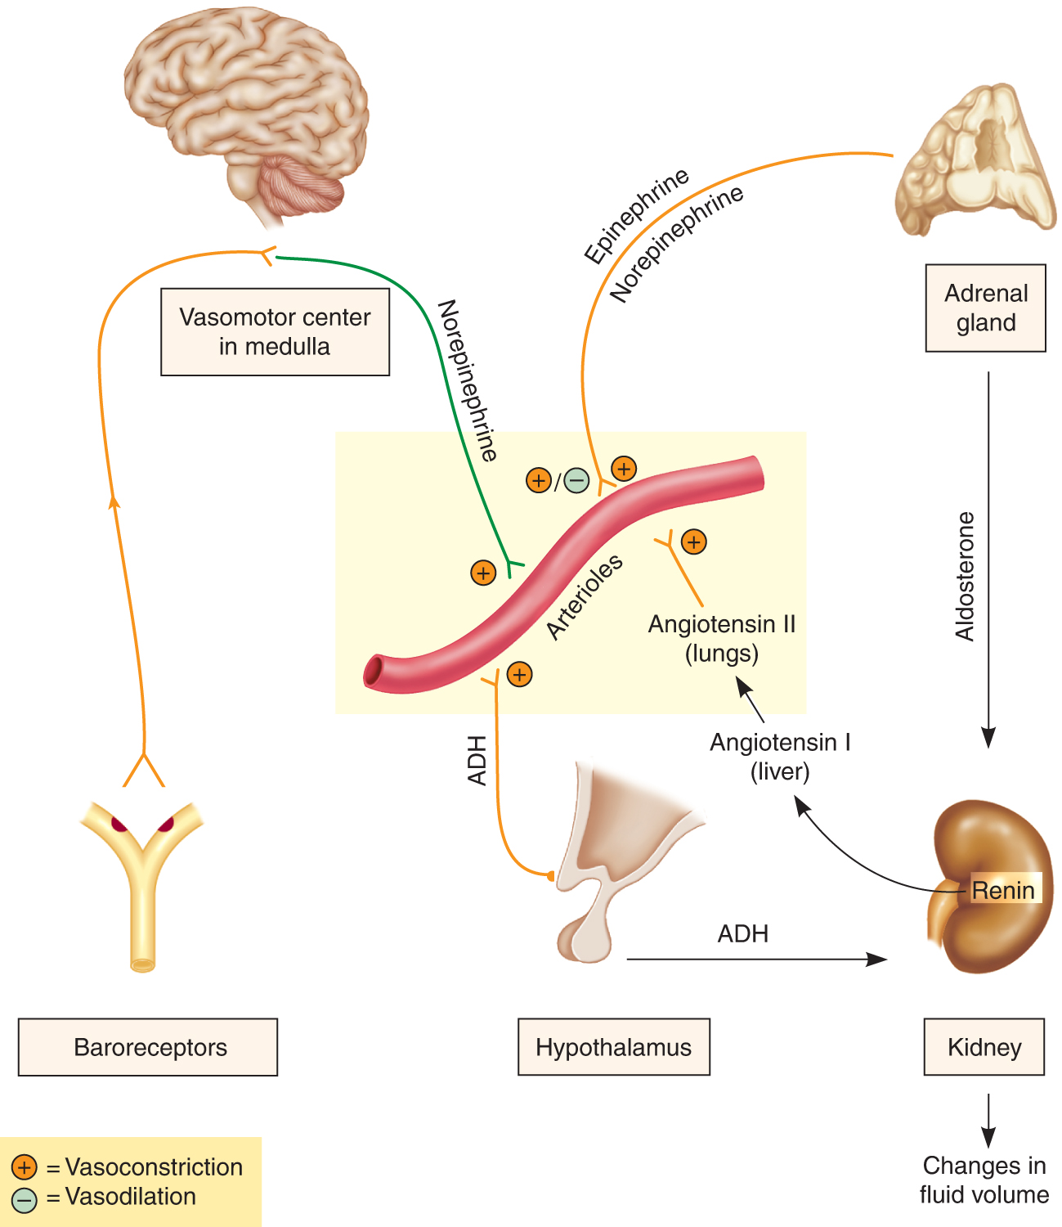
Figure 28-2 The renin–angiotensin system.

Slide 56
Hypertension
Antihypertensive Agents
  Vasodilators
    Produce direct relaxation of vascular smooth muscle
      Resulting in vasodilation
    Used with beta-blockers and diuretics
      To treat hypertension
continued on next slide

Slide 57
Hypertension
Antihypertensive Agents
  Vasodilators
    Adverse effects
      Headache
      Dizziness
      Tachycardia
      Nausea and vomiting
      Insomnia
continued on next slide

Slide 58
Hypertension
Antihypertensive Agents
  Vasodilators
    Adverse effects
      Nervousness
      Cutaneous flush
      Postural hypotension
      Bradycardia
      Heart failure
continued on next slide

Slide 59
Hypertension
Antihypertensive Agents
  Vasodilators
    Contraindications
      Hypersensitivity
      Coronary artery disease
      Rheumatic heart disease
      MI
    Interactions
      Beta-blockers
      Epinephrine
      Norepinephrine
      Guanethidine
continued on next slide

Slide 60
Hypertension
Antihypertensive Agents
  Vasodilators
    Monitor weight.
    Check for edema.
    Make position changes slowly.
    Avoid standing still.
    No excessive alcohol, driving, and other hazardous activities, until drug response is known.
    No breastfeeding

